Slide 1
Basic Linux Commands

Slide 2
File structure

Slide 3
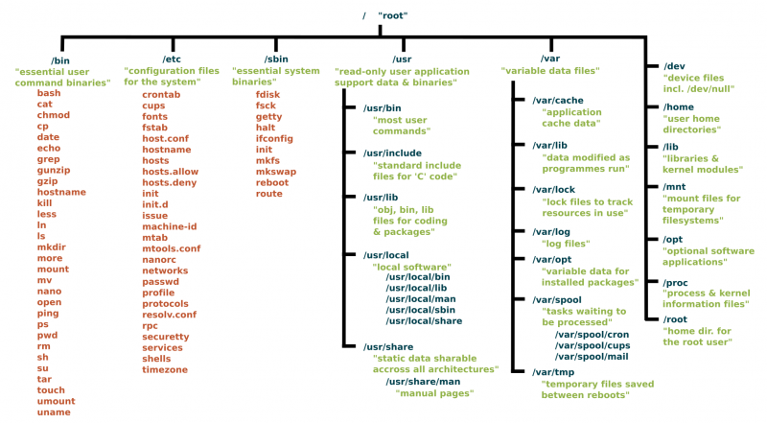
https://www.linux.com/sites/lcom/files/styles/rendered_file/public/standard-unix-filesystem-hierarchy.png?itok=CVqmyk6P

Slide 4
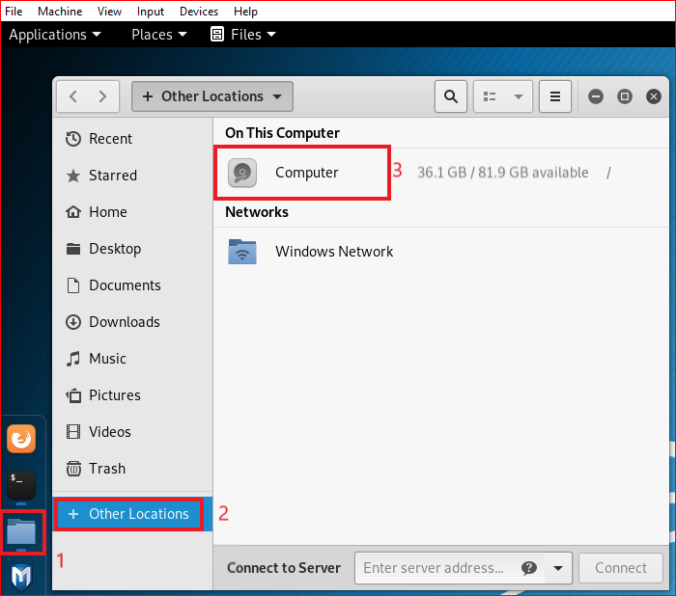

Slide 5
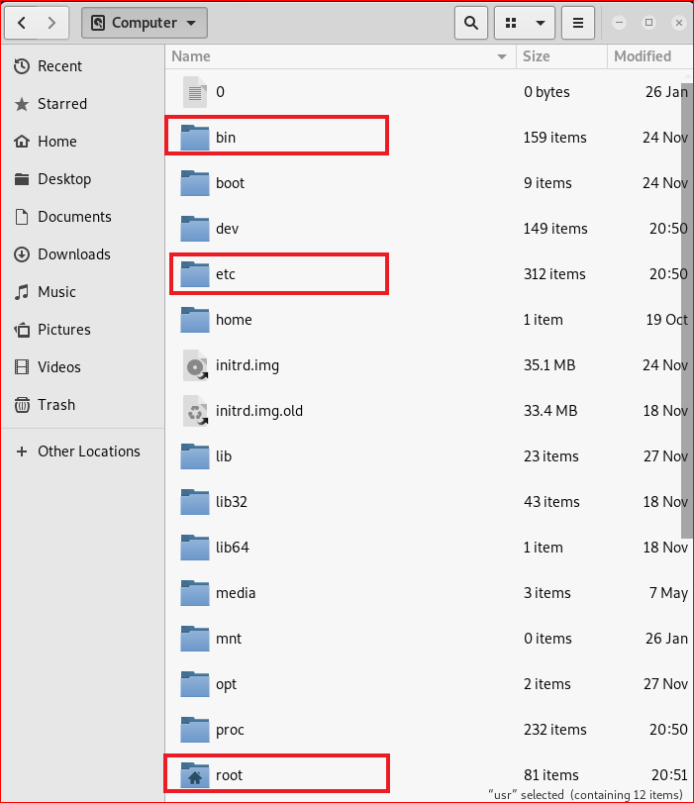

Slide 6
Folders

Slide 7
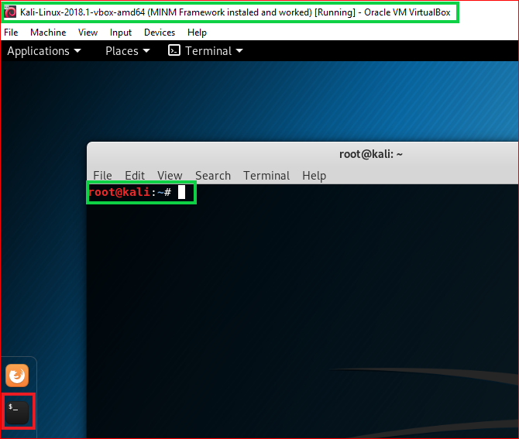

Slide 8
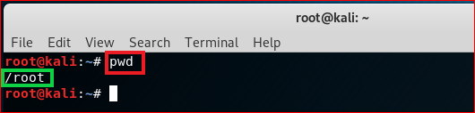
print working directory (pwd)

Slide 9

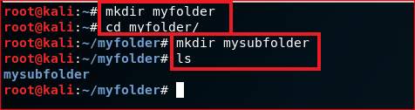
create folders
Root directory
root
\myfolder
\mysubfolder

Slide 10
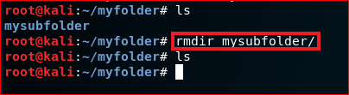
Delete folders

Slide 11
File operations

Slide 12
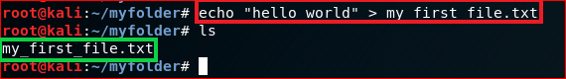
Create a new text file
root
\myfolder
hello world
my_first_file.txt

Slide 13
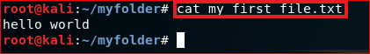
Show the content of the file: cat

Slide 14
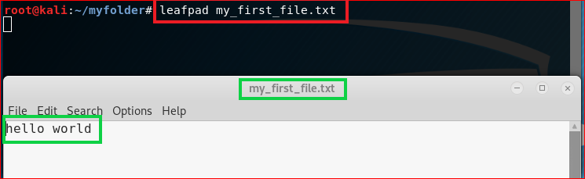
Show the content of the file

Slide 15
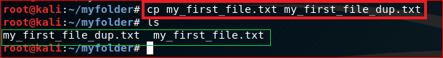
Copy (cp) a file

Slide 16
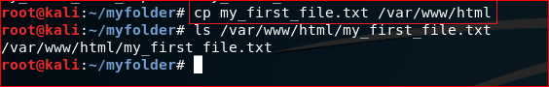
Copy (cp) a file to a different location

Slide 17
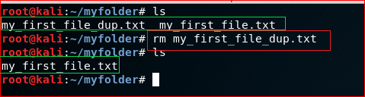
Remove a file: rm

Slide 18
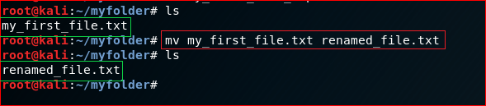
Rename a file (mv)

Slide 19
Networking

Slide 20
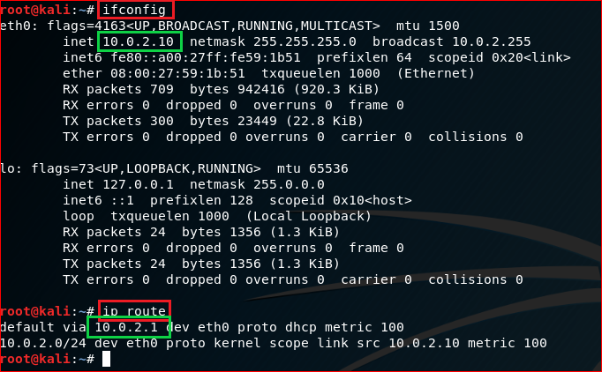
IP default gateway

Slide 21
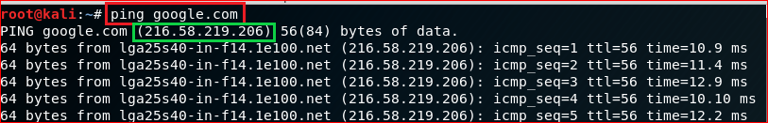
Test network connection using domain name

Slide 22
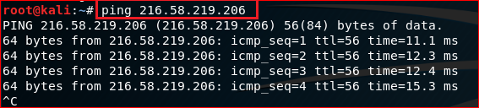
Test network connection using IP

Slide 23
Download files

Slide 24
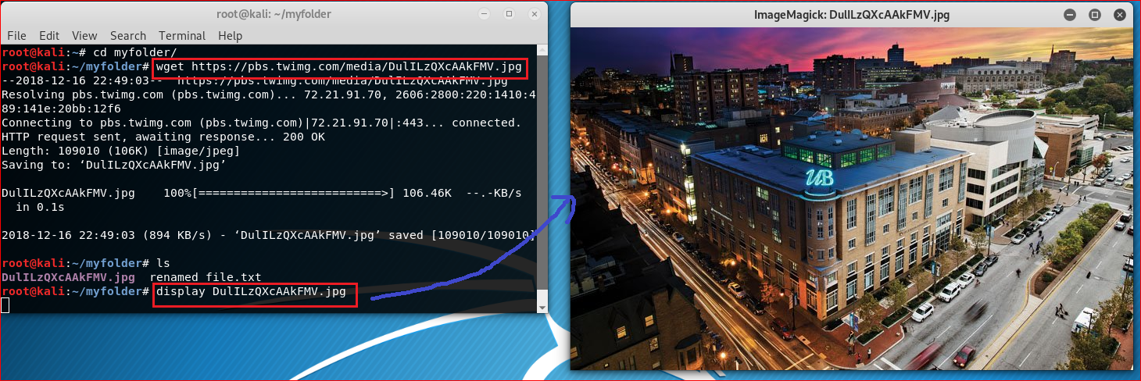
https://pbs.twimg.com/media/DulILzQXcAAkFMV.jpg

Slide 25
Update/Install software

Slide 26
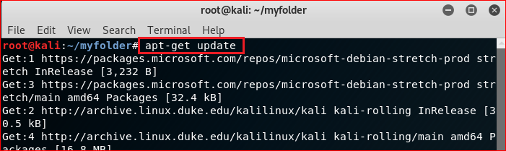
Update software

Slide 27
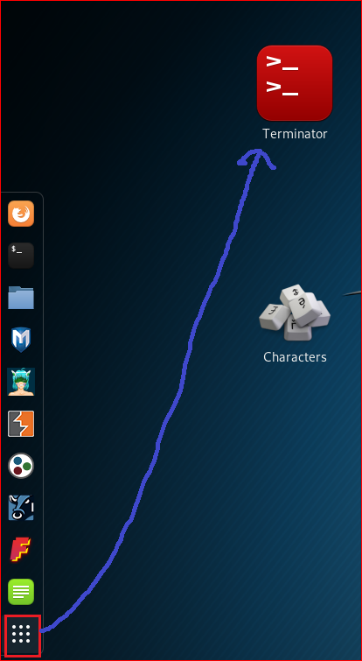
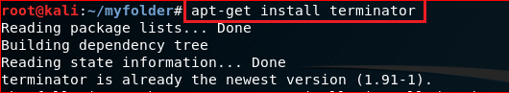
Install terminator

Slide 28
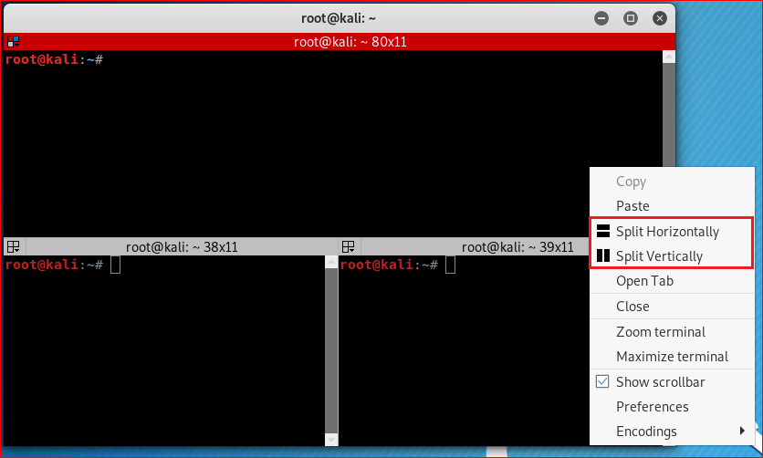

Slide 29
Compress files

Slide 30
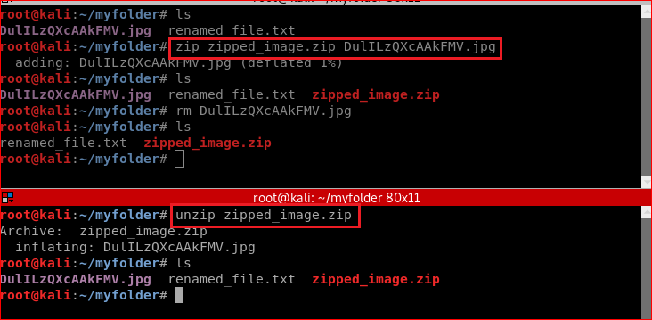
Zip/unzip files

Slide 31
Reference
https://www.linux.com/blog/learn/intro-to-linux/2018/4/linux-filesystem-explained

